Slide 1
Briefing for dog show judges
Updated 28.4.2025

Slide 2
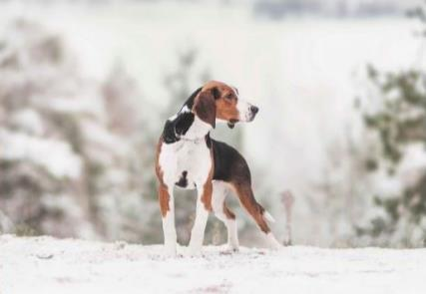
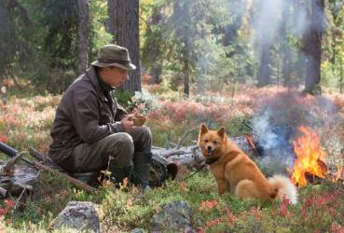
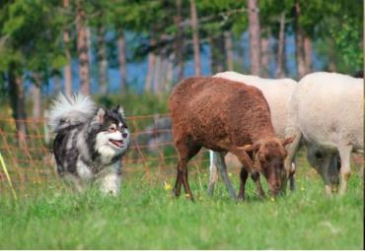
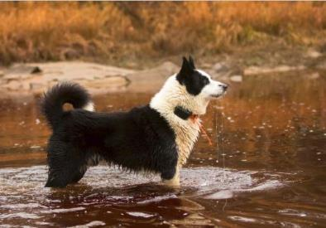
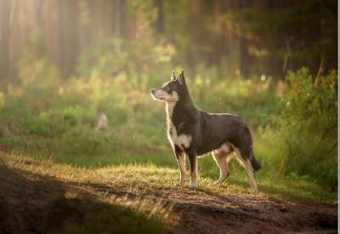
Welcome to Finland

Slide 3
The Finnish Kennel Club
The Finnish Kennel Club was established in 1889 (135 000 members)
There are about 800,000 dogs in Finland (2024) and pedigree dogs account for approx. 70% of this number.
Finland is home to more than 300 dog breeds and each of them has its own breed association.
The Finnish Kennel Club registers some 40,000 dogs each year.
The first dog show was arranged in 1891.
Shows are extremely popular in Finland.
About 300 shows / year (45 all breed shows)
The annual number of dog show entries exceeds 179,000

Slide 4
Dog welfare
The health and wellbeing of dogs is the primary concern in all Finnish Kennel Club's rules and activities related to dog breeding
  Dog shows as well!
Our rules are in harmony with the Animal Welfare Act and the Animal Welfare Decree as well as with other official regulations which apply to the breeding of animals

Slide 5
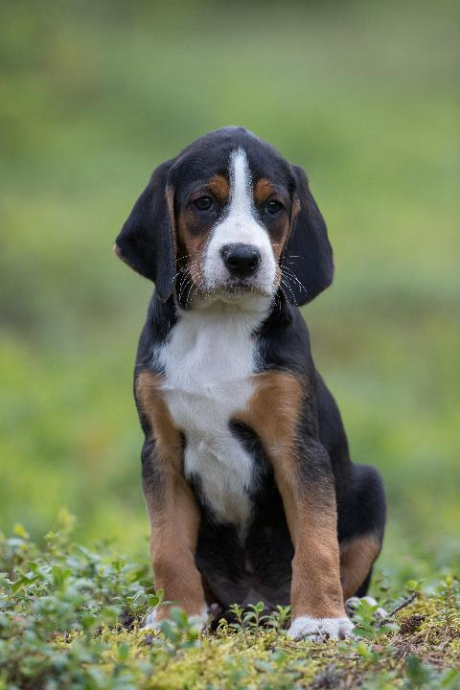
Welcome to the XXX show
Total number of dogs: XXXX
Judges: XX
Countries: XX
Rings: XX

Slide 6
Judges - rings
Hall 1
Ring 1 Timo Tuomari
Ring 2 XXX
…

Slide 7
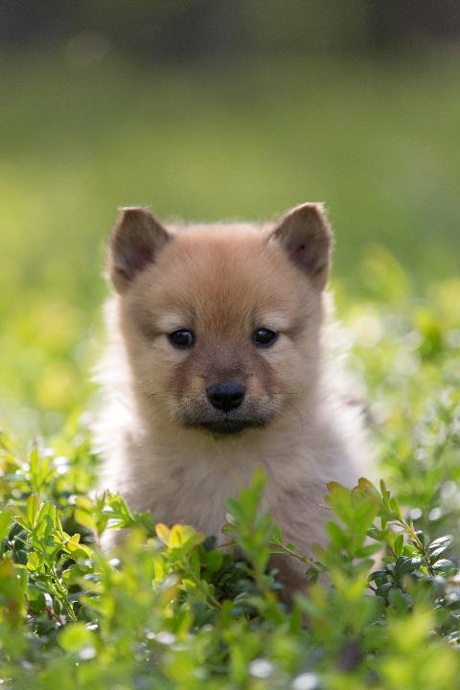
Finals
FCI 1 Timo Tuomari
FCI 2 XXX
…
BIS vet XXX
BIS breeders group XXX
BIS XXX
Time

Slide 8
Finnish show rules
JUNIOR CLASS from 9 to 18 months
INTERMEDIATE CLASS from 15 to 24 months
OPEN CLASS 15 months and over
WORKING CLASS 15 months and over, working test certificate required
CHAMPION CLASS 15 months and over
VETERAN CLASS 8 years and over
BREEDERS CLASS four dogs from the same breeder or having the same
kennel affix; critiques and only placing, HP to those worth it
Unofficial:
PUPPY CLASS 5 to 7 months (only in breed specialties), 7 to 9 months;
critiques but no grading, only placing, HP to those worth it

Slide 9
Written critique
Each dog is judged against the FCI breed standard and
Each dog is given a written critique and graded according to its quality
A written critique of approximately 20–50 words
The critique should indicate the reason for the grading

Slide 10
Evaluation of the dog’s behaviour
Attitude to judge
  can be handled
  avoids contact
  aggressive
General behaviour – if the dog is
  fearful
  aggressive towards other dogs
A report must be filled in about the dog if it is graded with ’disqualified’ due to aggressive behaviour in the ring

Slide 11
Grading
excellent
very good
good
sufficient
  pet quality, a really poor specimen of the breed
disqualified
  faults mentioned as disqualifying in the breed standard
  aggressive behaviour (also a report must be filled in)
  even though grading is ’disqualified’, a WRITTEN CRITIQUE MUST BE GIVEN
cannot be judged
  gait and movement cannot be assessed
  cannot be examined to inspect its bite, teeth, anatomy, construction, tail or testicles
  even though grading is ’cannot be judged’, a WRITTEN CRITIQUE MUST BE GIVEN about other aspects of the dog

Slide 12
Placing
Excellents and very goods (if less than four ’excellents’ in class)
are placed from 1 to 4 in each class
After placing the judge can decide
how many ’CC quality’ (CQ) gradings he/she wants to give
to the ones graded ’excellent’

Slide 13
Junior CAC (JCAC) / Veteran CAC (VCAC)
Junior CAC is awarded in the junior class to the best placed dog and bitch with CQ and which is eligible to receive it
  three JCACs from three different judges are needed for Finnish Junior Champion title
Veteran CAC is awarded in the veteran class to the best placed dog and bitch with CQ and which is eligible to receive it
  three VCACs from three different judges are needed for Finnish Veteran Champion title
In international shows, the dog and bitch with ‘Excellent 1 + CQ’ in junior and veteran classes can be awarded with a CACIB-J and CACIB-V
There are no reserve awards for JCAC, VCAC, CACIB-J and CACIB-V

Slide 14
Best dog / best bitch class and CAC
All the CC quality dogs placed in their own classes take part in the best dog/bitch class
Dogs and bitches are placed from 1 to 4
One CAC to the best placed dog and bitch which is eligible to compete for it
One res-CAC to the next best placed dog and bitch which is eligible to to compete for it

Slide 15
CACIB, NORD CAC and BOB
CACIB and reserve-CACIB
To the best placed dog and bitch from other than junior or veteran class
To the next best placed dog and bitch from other than junior or veteran class
NORDIC CAC and reserve-NORDIC CAC
To the best placed dog and bitch which is not a Nordic Champion
To the next best placed dog and bitch which is not a Nordic Champion
BOB competition between the Best Dog and the Best Bitch!
  In Finland also the veteran and the junior can win BOB
BOB veteran
BOB junior
BOB puppy (if puppy classes included in the show)
BOB breeder’s group

Slide 16
Breed specific instructions (BSI)
Basics for all dogs
  breathing
  eyes
  bite and teeth
  weight
  skin and coat
  movement
  behaviour
Special attention points for the listed breeds

Slide 17
Breed specific instructions (BSI) for listed breeds
The report must be filled in AFTER EACH BSI BREED
  only after that the judging continues with the next breed
It takes only 5 minutes to fill in the report
The report can be filled in also from other than BSI breeds
The report is basically filled in by ticking boxes, all comments about the points to be noted are highly appreciated
Please mark clearly the amount of dogs which had any of the exaggerated characteristics or other points to note (both positive and negative)

Slide 18
Note!
NOTE! all chalking, spraying, dyeing etc. is strictly forbidden
Only the veterinary documents written on the Finnish Kennel Club’s official form are taken into consideration if the judge so wishes
The testicles of all male dogs must be checked
Docked and/or cropped dogs born after 1.1.2001 cannot be shown

Slide 19
Other remarks
Group finals
  pre-judging in the collecting rings before going into the main ring
  in the main ring make a short list of 6 to 8 dogs
Trainee judges
  qualified judges who are studying a new breed
  the judge is expected to teach them by discussing the exhibits
Travel expenses
  Reimbusement form (including SSN or DOB) with all required receipts included

Slide 20
Have a nice show day!
If any questions, just ask your ring steward or show committee!
Show lunch, place and time
Treasurer, travel costs
Transportation
Dinner time and place
Other relevant information

Slide 21
Finnish breeds
There are five domestic breeds in Finland: the Karelian Bear Dog, the Lapponian Herder, the Finnish Hound, the Finnish Lapponian Dog, and our national breed, the Finnish Spitz.
The breeds constitute an integral part of the Finnish cultural heritage. The Finnish Kennel Club and the breed clubs representing Finnish breeds have an important task: to guarantee that the breeds are preserved and that they are viable also in the future.

Slide 22
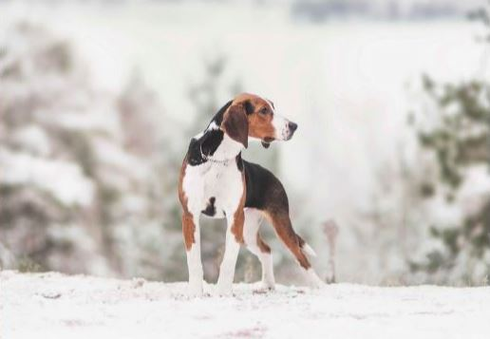

Finnish Spitz
Finnish Hound
The Finnish Hound is used almost
solely to hunt hares or foxes.
The Finnish Spitz primarily barks at birds
up in trees, using its voice to indicate
the location of game.

Slide 23

Finnish Lapponian Dog
The Finnish Lapponian Dog shares its roots with the Lapponian Herder and the Swedish Lapphund.
It is descended for the long-haired reindeer herding dogs that are common in the fell regions of Lapland.

Slide 24


Lapponian Herder
The Lapponian Herder serves nowadays mainly as a companion dog and it is also widely used for different canine activities.
Karelian Bear Dog
The Karelian Bear Dog is mainly used by hunters to corner elk and bear.

